Slide 1
Advancing Digital Supply Chains in Construction Products through Standardisation
Finnish Association of Construction Products Industries
Teemu Alaluusua
2025-10-07 / Digital Construction Workshop – Construction Products Europe

Slide 2
Contents
Production strategies point of view for development
Current state of digital supply chain management, Engineer-to-Order Precast Concrete
Development Roadmap
Standards to Follow in Supply Chain Digitalization
Developed Implementation Guidelines for Supply Chain Data Exchange
Future state data flow architecture, Engineer-to-Order Precast Concrete
2

Slide 3







Production chains in the construction industry
. . . .
Value chain of the construction project
Project Consideration
Design
Project developer
Costing & Approvals
PRODUCTION STRATEGY PERSPECTIVE ON DEVELOPMENT
Procurement
Architects, Structural engineers, MEP-designers
Material Extraction & Delivery
Product Manufacturing
Delivery
Contractor
On-Site Assembly
Supplier
Manufacturer
Product Supply Chain
Operation
FM
. . . .
Demolition
. . . .
The figure depicts the value chain of the construction project (↓) and the supply chain of the construction products linked to it (→)
3

Slide 4








Production chains in the construction industry
. . . .
Value chain of the construction project
Project Consideration
Design
Project developer
Costing & Approvals
Procurement
Architects, Structural engineers, MEP-designers
Material Extraction & Delivery
Product Manufacturing
Delivery
Contractor
Product design
Parts manufacturing
Assembly
Storage
On-Site Assembly
Product design
Assembly
Parts manufacturing
Assembly
Storage
Product design
Parts manufacturing
Supplier
Manufacturer
Product Supply Chain
Engineer-to-
Order
Make-to-
Order
Assembly-to-
Order
Make-to-
Stock
Operation
FM
. . . .
Demolition
. . . .
The production strategy determines the customer order decoupling point, illustrating where production control transitions from push to pull across MTS, ATO, MTO, and ETO models.
4

Slide 5







Production strategies for building products
BETONI
Engineer-to-
Order
Make-to-
Order
Assembly-to-Order
Make-to-
Stock
Project-specific products
Standard products
In Finland, we are currently working on the precast concrete supply chain as an Engineer-to-Order reference case
Delivery
5
Notes:
The development work in Finland is carried out in supply chain work groups, which are divided according to the production strategies.
In Finland, we are currently working on the precast concrete supply chain as an Engineer-To-Order reference case.

Slide 6

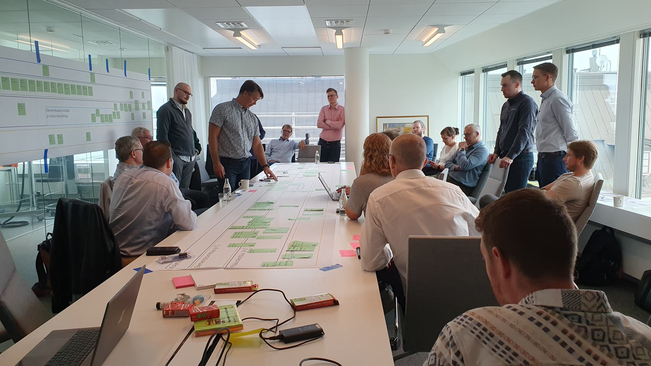
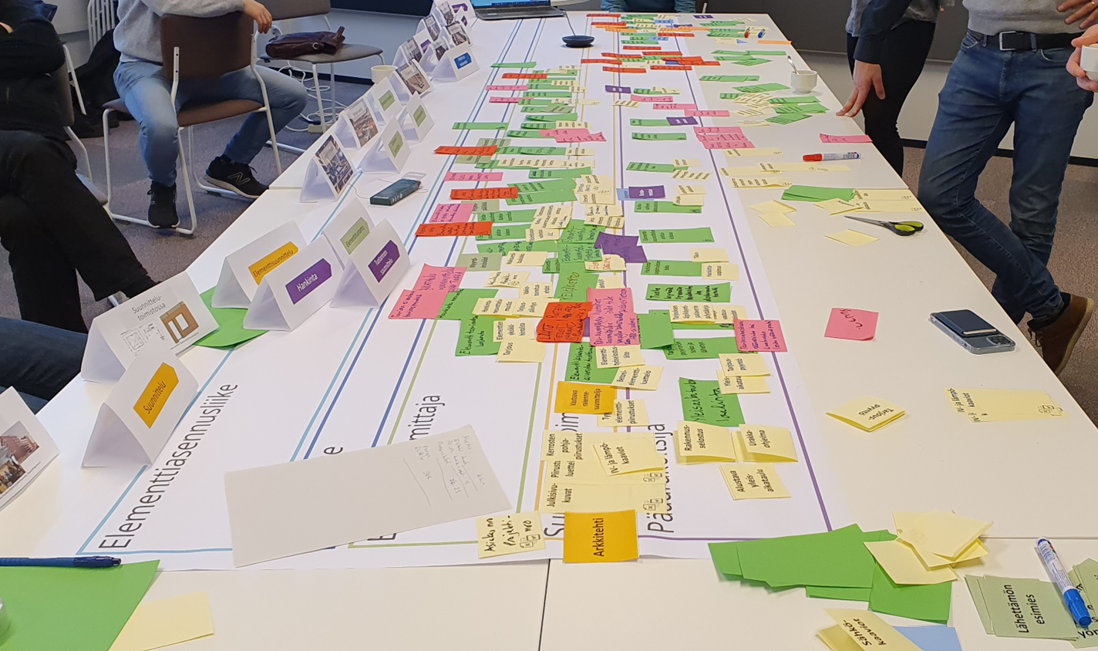
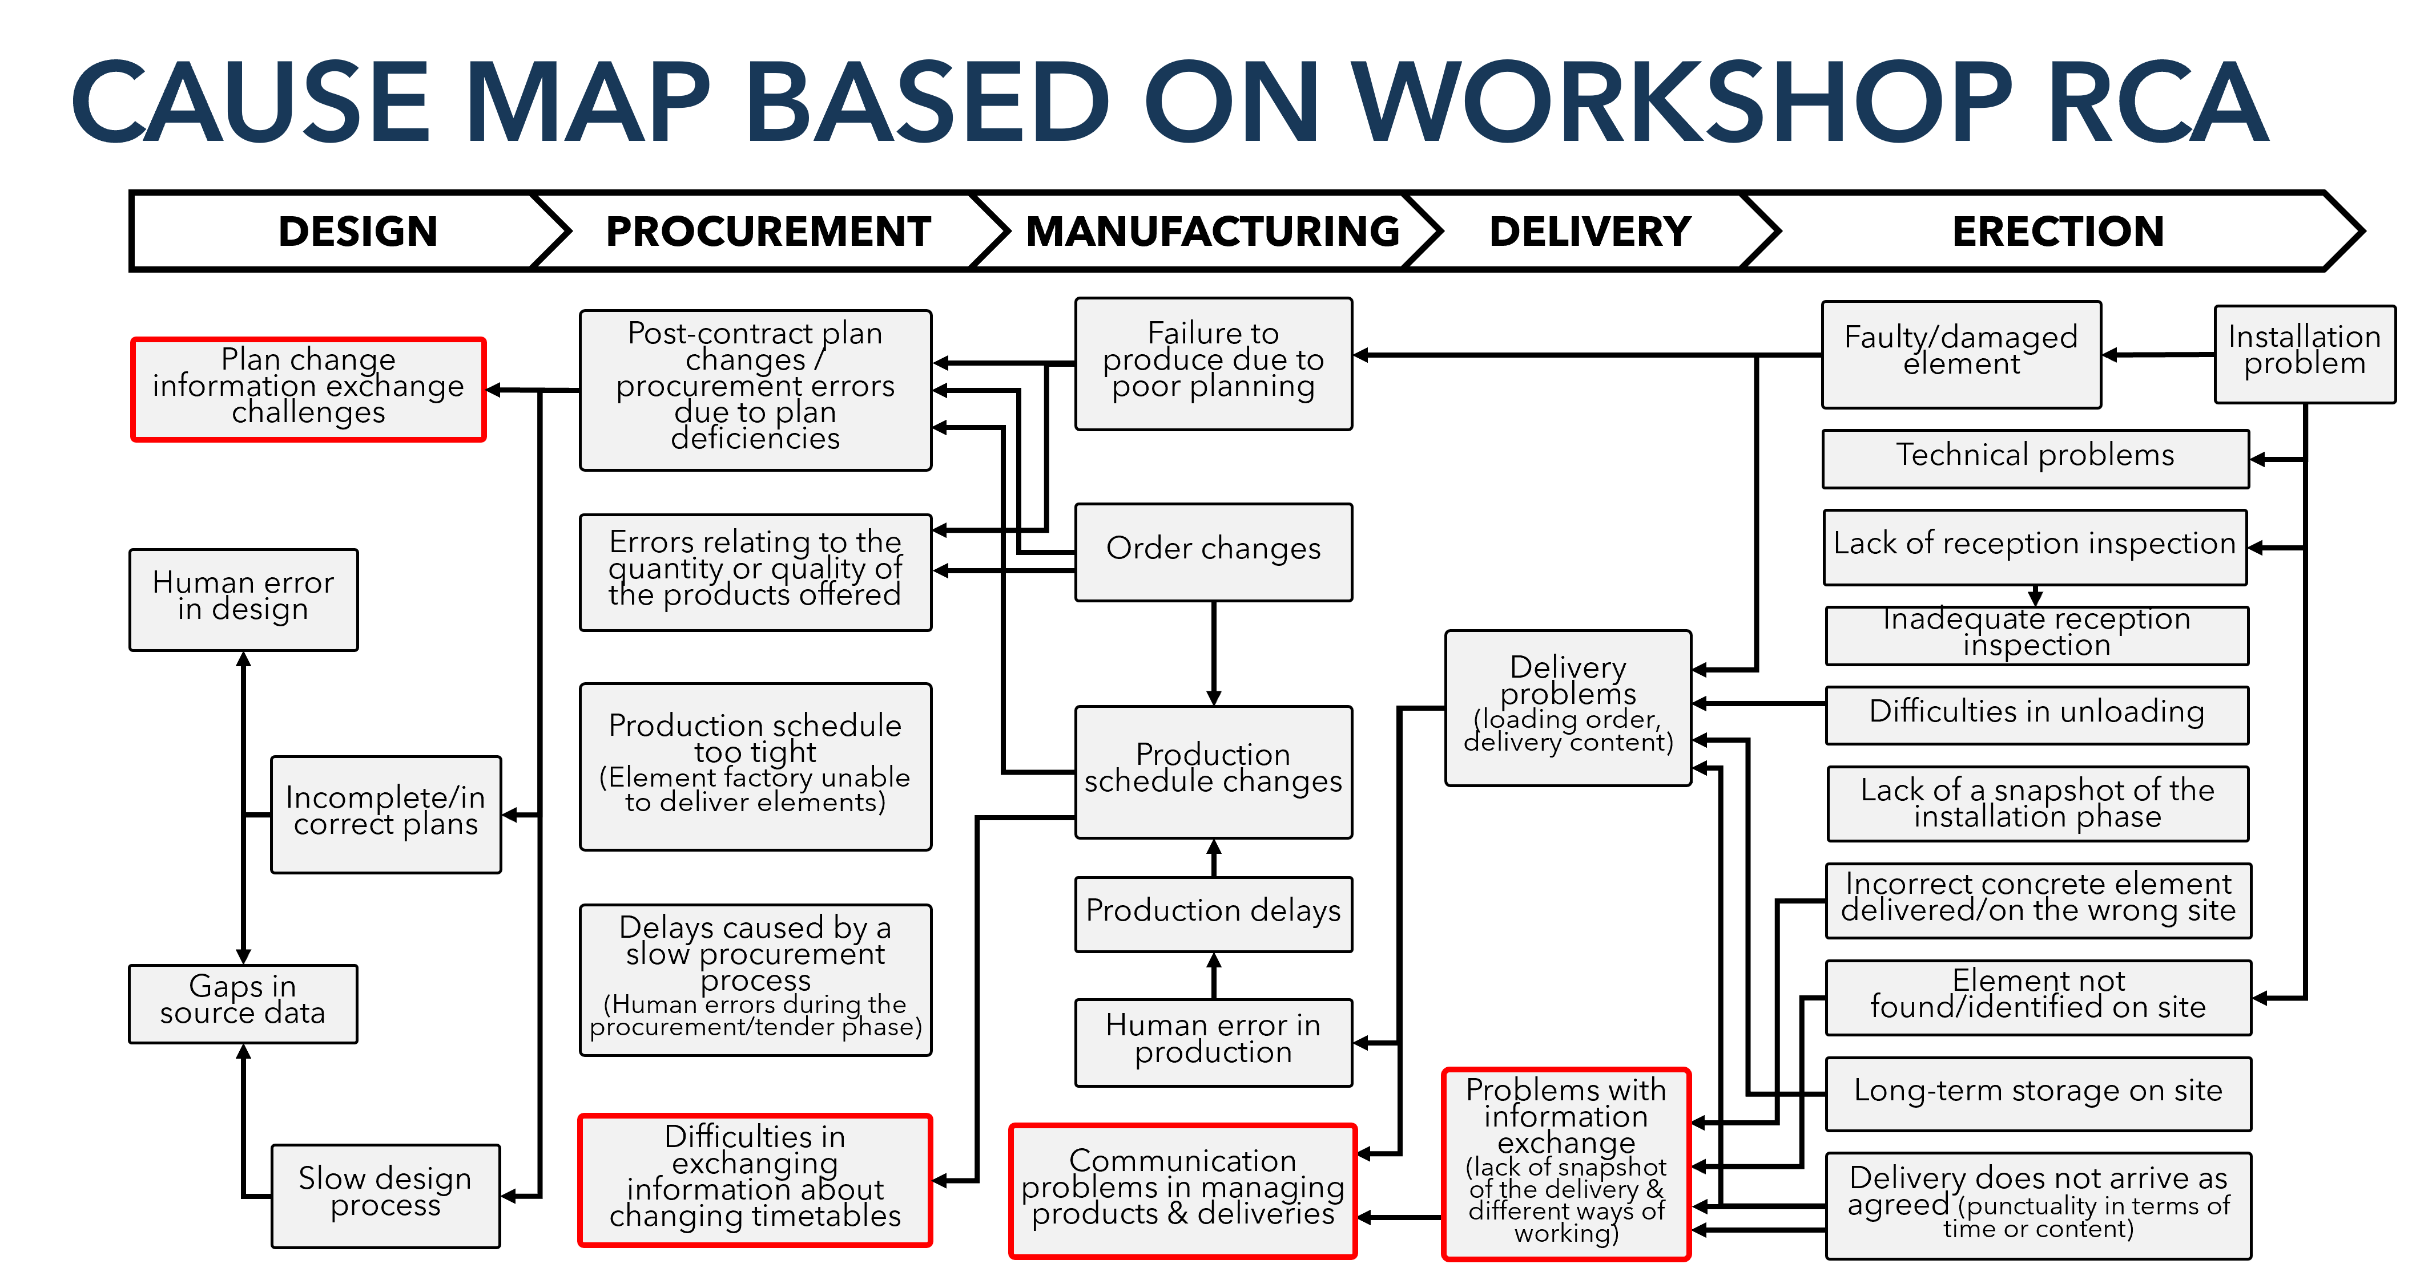
Current State
(Based on preliminary studies & workshops results )
BIM data is not usable across the supply chain.
Lack of linked building data prevents seamless information flow between stakeholders.
Current data architecture is based on closed information exchange systems.
Point-to-point, customized integrations are inefficient and costly.
Lack of interoperability between systems and platforms.
Unstructured data (PDFs, images, phone calls, emails) dominates communication, making automation and analytics difficult.
Fig 1. Alhava, O (2023)
Fig 2. Alaluusua, T (2023)
Current State
Development roadmap
Future State
Ref. Alaluusua, T. (2023) Digital management of information exchange in takt production supply chains
Ref. Alhava et al. (2024) Challenges and Opportunities in Digitalising Concrete Element Supply Chain: Proposed National Model
Notes:
The development project was initiated through preliminary studies conducted on construction sites, followed by a series of supply chain workshops involving industry experts. The aim was to map the current processes of the precast concrete element supply chain — covering all stages from design to installation — and to identify issues occurring in different parts of the chain.
During these workshops, each stage of the process was analyzed, including the stakeholders involved, the current methods and formats of information exchange, and the challenges encountered.
The key findings were related to the flow of information between different phases of the supply chain.

Slide 7
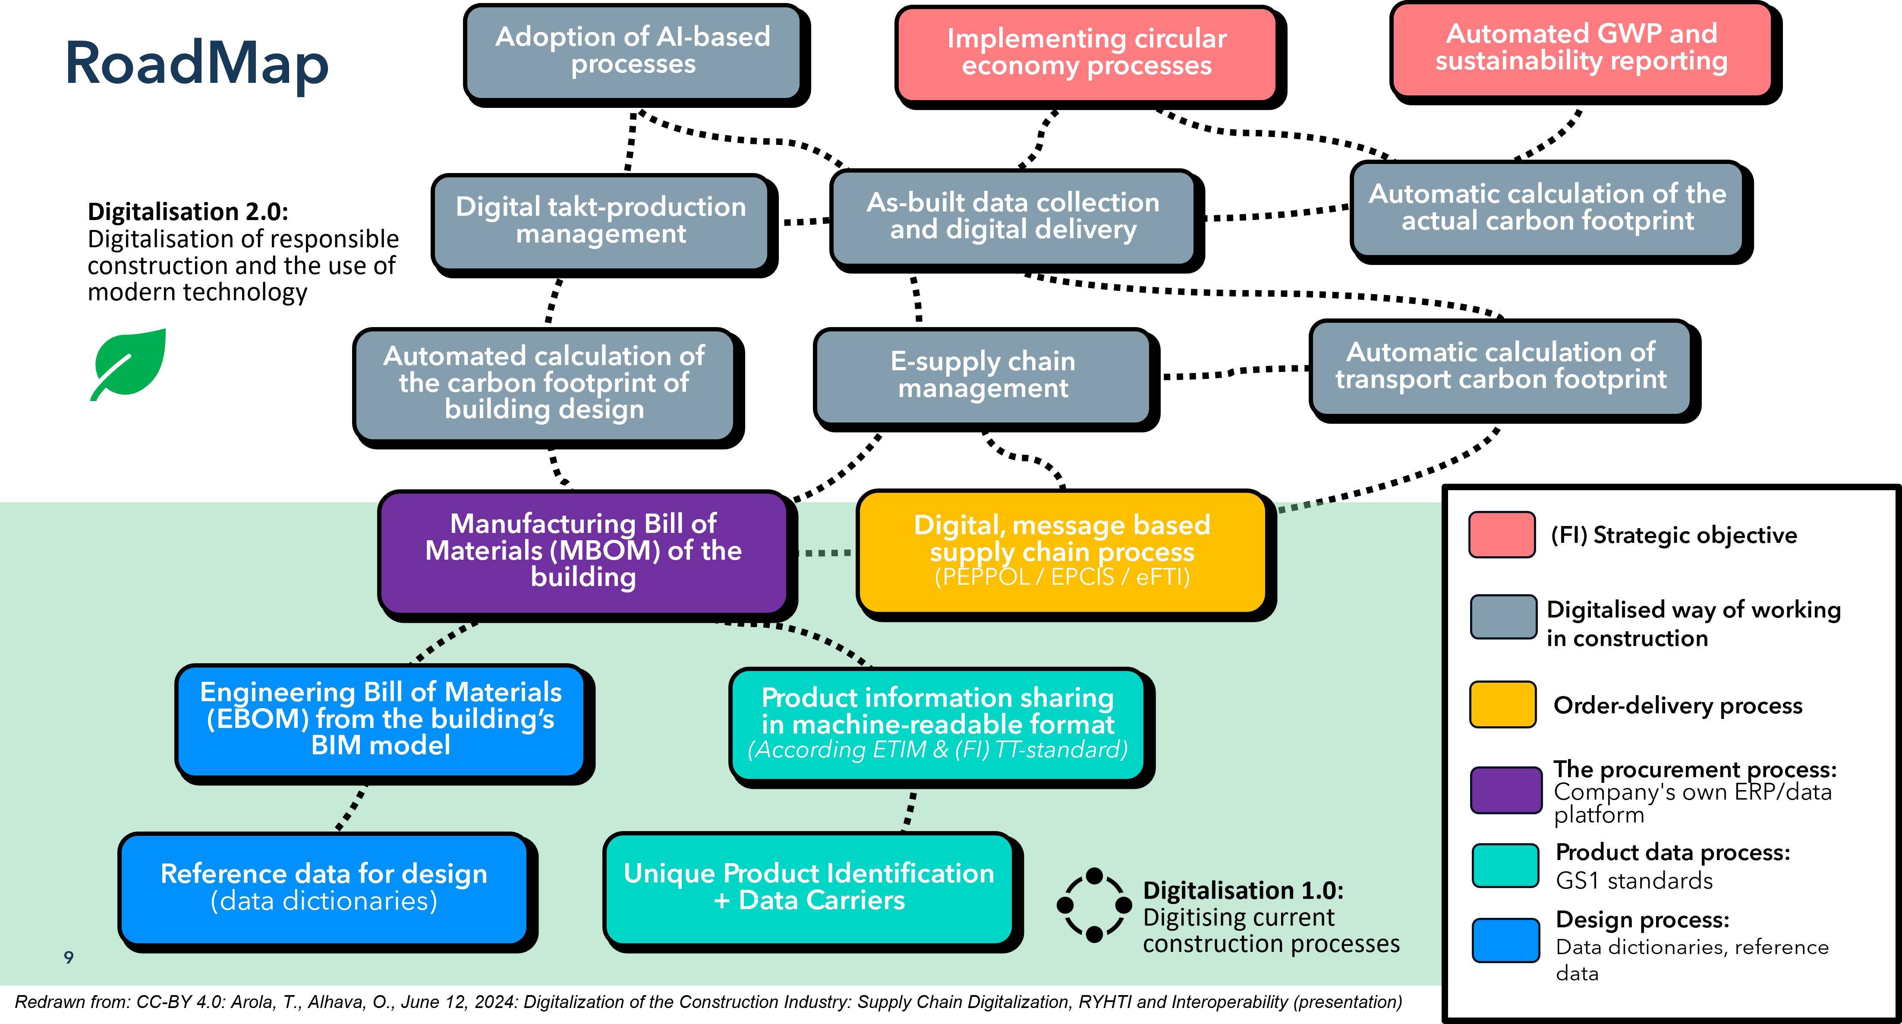
public authorities
IT
companies
Development Roadmap
Based on the current state analysis, we developed a general development roadmap that covers all production strategies.
Our findings show that advancing digital supply chains requires the comprehensive development of operations, information management, and technology systems.
To achieve the best results, we collaborate with experts from various organizations, including academia, industry practitioners, non-profit associations, public authorities, and IT companies.
Non-profit associations
Industry practitioners
Academia
Current State
Development roadmap
Future State
Notes:
Based on the current state analysis, we developed a general development roadmap that covers all production strategies.
Our findings show that advancing digital supply chains requires the comprehensive development of operations, information management, and technology systems.
To achieve the best results, we collaborate with experts from various organizations, including academia, industry practitioners (manufacturers, contractors, designers), non-profit associations, and public authorities such as the State Treasury, the Ministry of the Environment, and the Finnish Tax Administration, as well as IT companies.

Slide 8


Development Roadmap
Adoption of AI-based processes
Implementing circular economy processes
Automated GWP and sustainability reporting
Digital takt-production management
As-built data collection and digital delivery
Automatic calculation of the actual carbon footprint
Digitalisation 2.0:
Digitalisation of responsible construction and the use of modern technology
Automated calculation of the carbon footprint of building design
E-supply chain management
Automatic calculation of transport carbon footprint
Manufacturing Bill of Materials (MBOM) of the building
Digital, message based supply chain process
(PEPPOL / EPCIS / eFTI)
(FI) Strategic objective
Digitalised way of working in construction
Engineering Bill of Materials (EBOM) from the building’s BIM model
Product information sharing in machine-readable format
(According to ETIM & (FI) TT-standard)
Order-delivery process
Peppol, EPCIS, eFTI
The procurement process: Company's own ERP/data platform
Reference data for design
(data dictionaries)
Unique Product Identification + Data Carriers
Product data process:
GS1 standards
Digitalisation 1.0:
Digitising current construction processes
8
Design process:
Data dictionaries, reference data
Redrawn from: CC-BY 4.0: Arola, T., Alhava, O., June 12, 2024: Digitalization of the Construction Industry: Supply Chain Digitalization, RYHTI and Interoperability (presentation)
Notes:
About the Development Roadmap Framework for the Digitalisation of Construction Supply Chains
This figure presents the action points of current construction processes that represent Digitalisation 1.0 — the foundation that must be addressed to enable Digitalisation 2.0, focusing on responsible construction and the use of modern technologies.
The roadmap covers several process areas:
Design process: Establishing reference data for design and ensuring export of relevant information forward along the supply chain.
Product data process: Applying GS1 identification and data capture methods and enabling machine-readable product information sharing.
Procurement process: Combining product and design data to generate the manufacturing Bill of Materials (mBOM).
Order and delivery process: Standardising data exchange using formats such as Peppol, eFTI, and EPCIS.
By implementing these actions, we can achieve a more digitalised and data-driven way of working in construction.

Slide 9
Standards to Follow in Supply Chain Digitalization
IFC
Data model –schema and format
Data templates, properties
Information management
Processes – how to work in the project using BIM
Order-delivery process
GS1 Standards
Peppol / UBL
Identification
Data Capture
EN ISO
16739:2024
EN ISO
23386:2020
EN ISO
23387:2020
EN ISO
19650-1:2018
EN ISO/IEC
19845:2015
GS1 GTIN
ISO/IEC 15459-6
ISO/IEC 6523
EAN/UPC barcode
ISO/IEC 15420
IFD classification, SML
Data dictionaries, classification, linked data
EN ISO
19650-2:2018
EN ISO
22057:2022
EN ISO/IEC
16931-1:2017
EN ISO
19650-3:2020
GS1 GLN
ISO/IEC 6524
GS1 Data Matrix
ISO/IEC 16022
EN ISO
12006-2:2020
EN ISO
19650-4:2022
GS1 SSCC
ISO/IEC 15459-1 ISO/IEC 6523
GS1 QR Code
ISO/IEC 18004
EN ISO
12006-3:2022
LOIN
Level Of Information Need
EPCIS (GS1)
EN ISO
19650-5:2020
GUID / UUID
EN ISO
7817-1:2024
GS1 EPCIS Standard:2022
GS1 GIAI
ISO/IEC 15459-4 & 5 ISO/IEC 6523
EPC Tag Data Standard
ISO/IEC 15962:2024
CEN/TR
17439:2020
ISO/IEC
9834-8:2005
GS1 CBV Standard:2022
GS1 GSRN
ISO/IEC 15418
ISO/IEC
11578:1996
GS1 EPCIS & CBV Guideline:2023
GS1 GRAI
EU DPP
XXXX XXXXX
GS1 GDTI
-
eFTI (EU)
EPD
CELEX
32020R1056
EN ISO
14025:2018
Notes:
From interoperability point of view, it is important to be aware of existing standards, implementation guidelines, legislation for design process, product data process, supply chain management, information sharing.
Here is listed a some of those existing ones that we are considering at our development work.

Slide 10
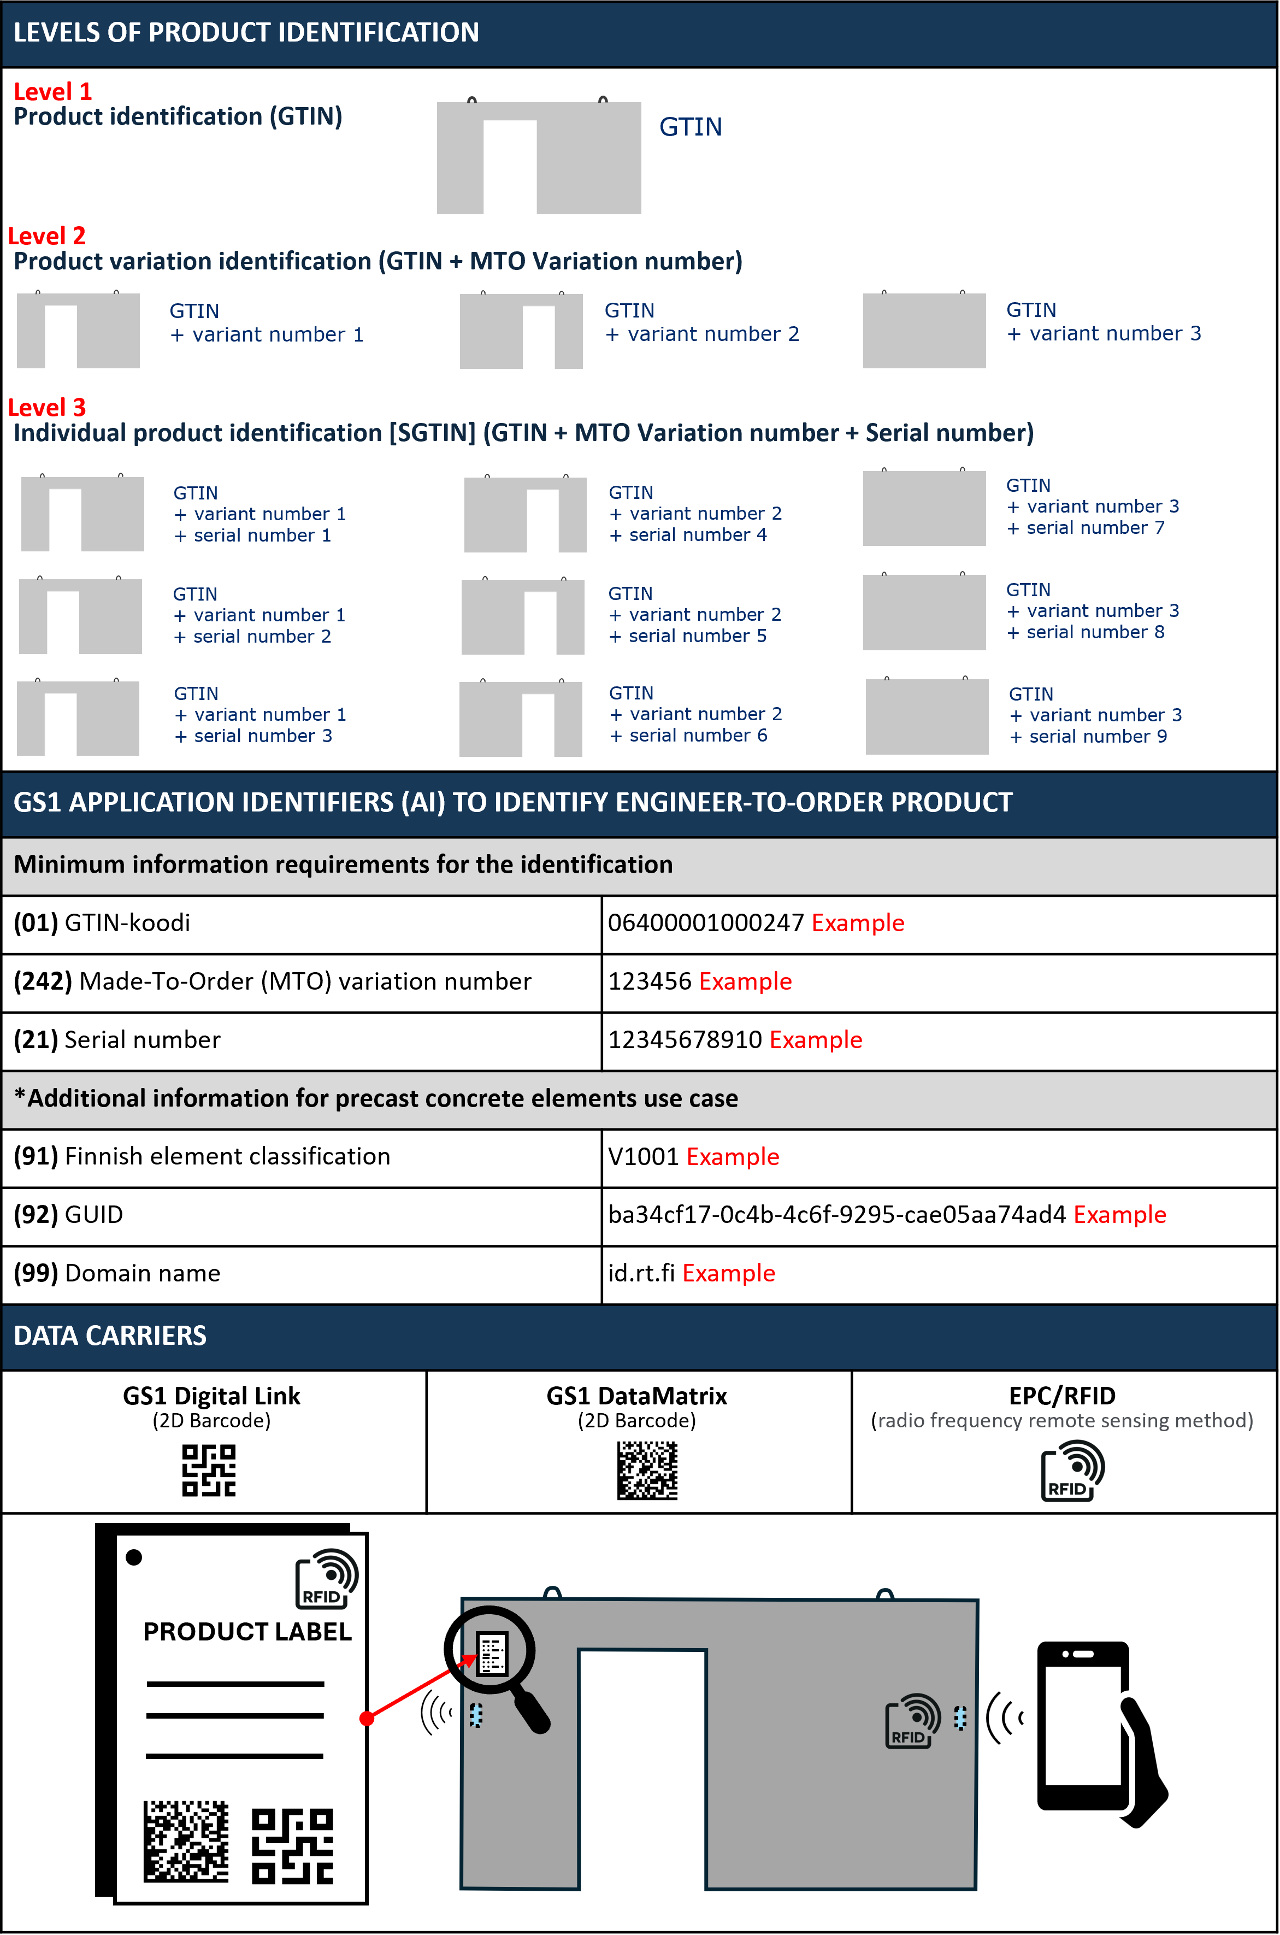
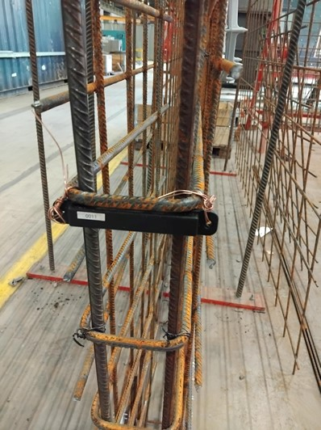
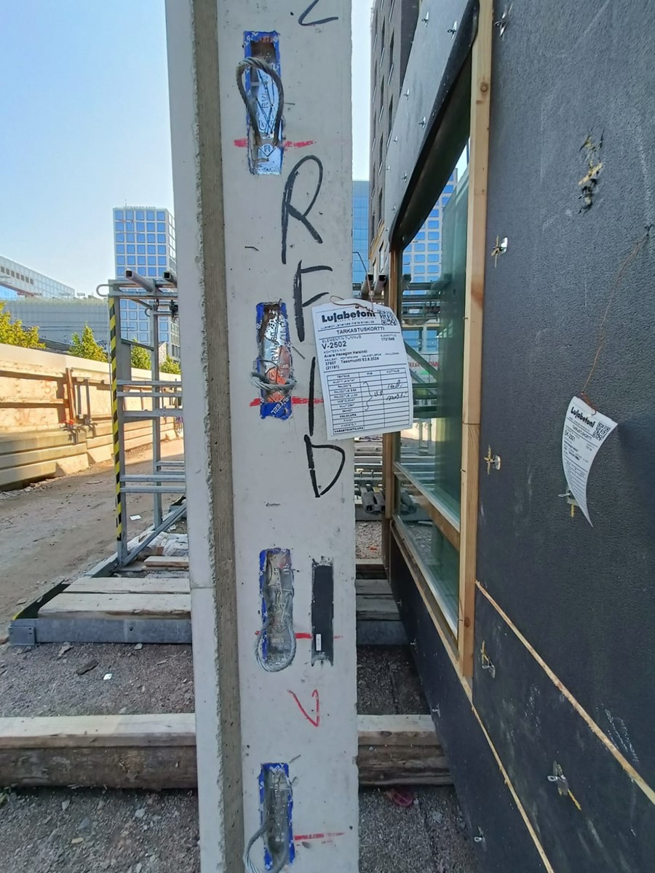
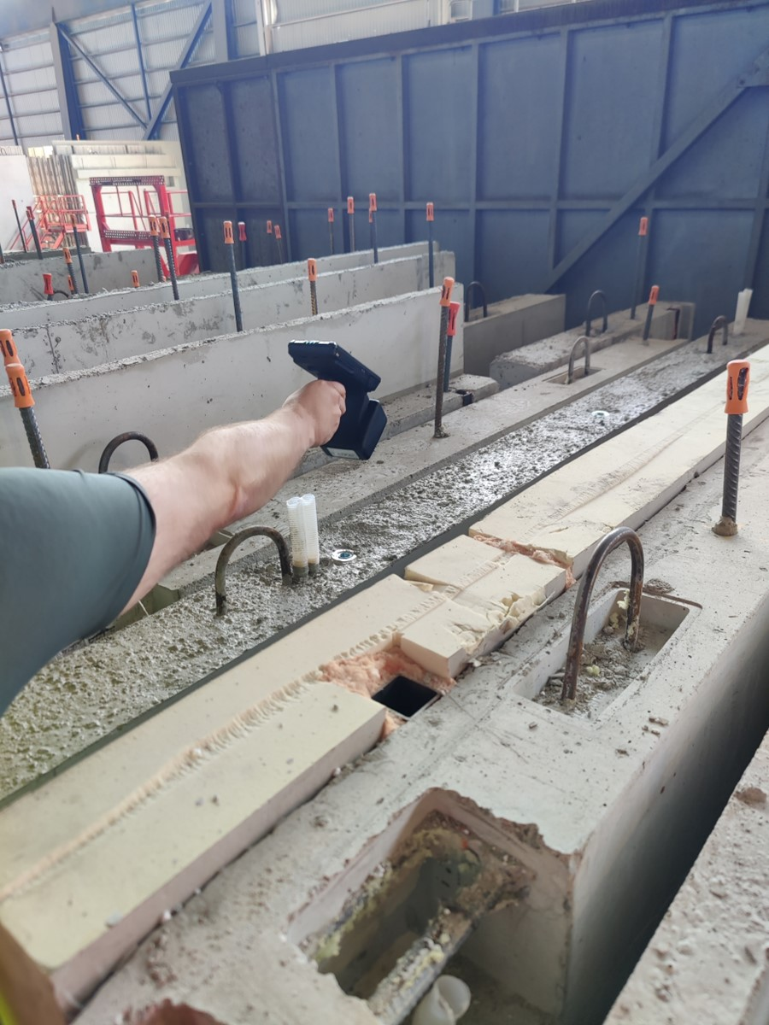
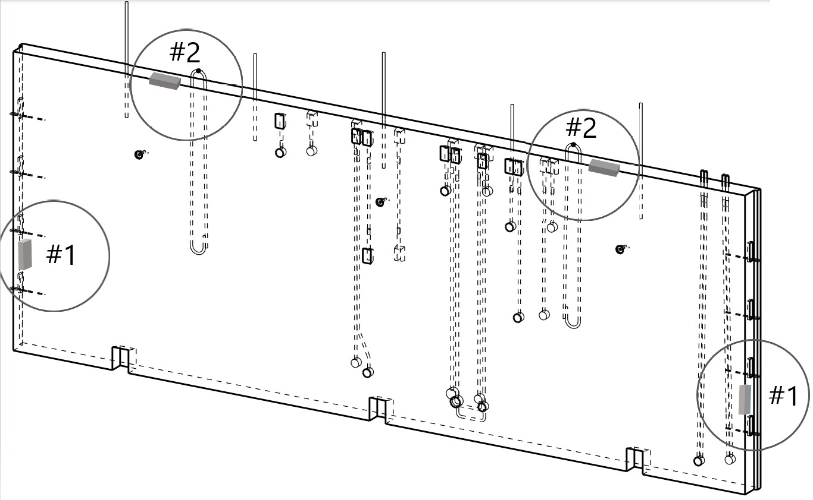
Implementation Guideline:
Unique Product Identification and Data Carriers for ETO Products
Previously based on manufacturers’ non-standardised internal codes
A GTIN alone identifies a general product category, not a unique item
Precast elements (ETO products) require a different approach for identification:
GTIN → identifies the base product type
MTO variant → identifies the specific variation
Serial number → distinguishes identical units

Slide 11



Industry-specific Peppol Implementation guidelines
(Pan-European Public Procurement Online)
Work in progress…
Peppol is a network, not a standalone system.
It aims to optimize the supply chain, not create a single central point.
Based on the international standard ISO/IEC 19845:2015 (UBL).
Already used in the construction industry in several Nordic countries.
Each country may have its own Peppol Authority responsible for national governance.
To connect to the Peppol network, organizations need an authorized Peppol service provider and a compatible system (e.g., order management or ERP system).
BIS Ordering 3.3
BIS Catalogue With Response 3.1
BIS Advanced Despatch Advice with Receipt Advice
. . .
. . .
Invoice
Fig. Peppol, 5-corner model for e-invoicing (2021).
NOT STANDARDISED
Peppol STANDARDISED
REGULATED
CORNER 1
CORNER 2
TAX DATA
INVOICE
PEPPOL BIS
SUPPLIER
(SENDER)
Peppol
service
provider
CORNER 5
CLEARED INVOICE
PEPPOL BIS
SML
SMP
Peppol
service
provider
TAX
ADMINISTRATION
DATA VAULT
CORNER 4
CORNER 3
INVOICE
TAX DATA
PEPPOL BIS
BUYER
(RECEIVER)
Peppol
service
provider
Service Metadata Provider (SMP), Service Metadata Locator (SML)
Notes:
Peppol is an international network that enables the exchange of standardized electronic documents such as catalogues, orders, order confirmations, invoices, and logistics documents.
In Finland, we are developing industry-specific Peppol implementation guidelines.
Currently, we are working on three Peppol Business Interoperability Specifications (BIS) used within the Peppol network:
BIS Catalogue with Response
BIS Ordering
BIS Advanced Despatch Advice with Receipt Advice

Slide 12
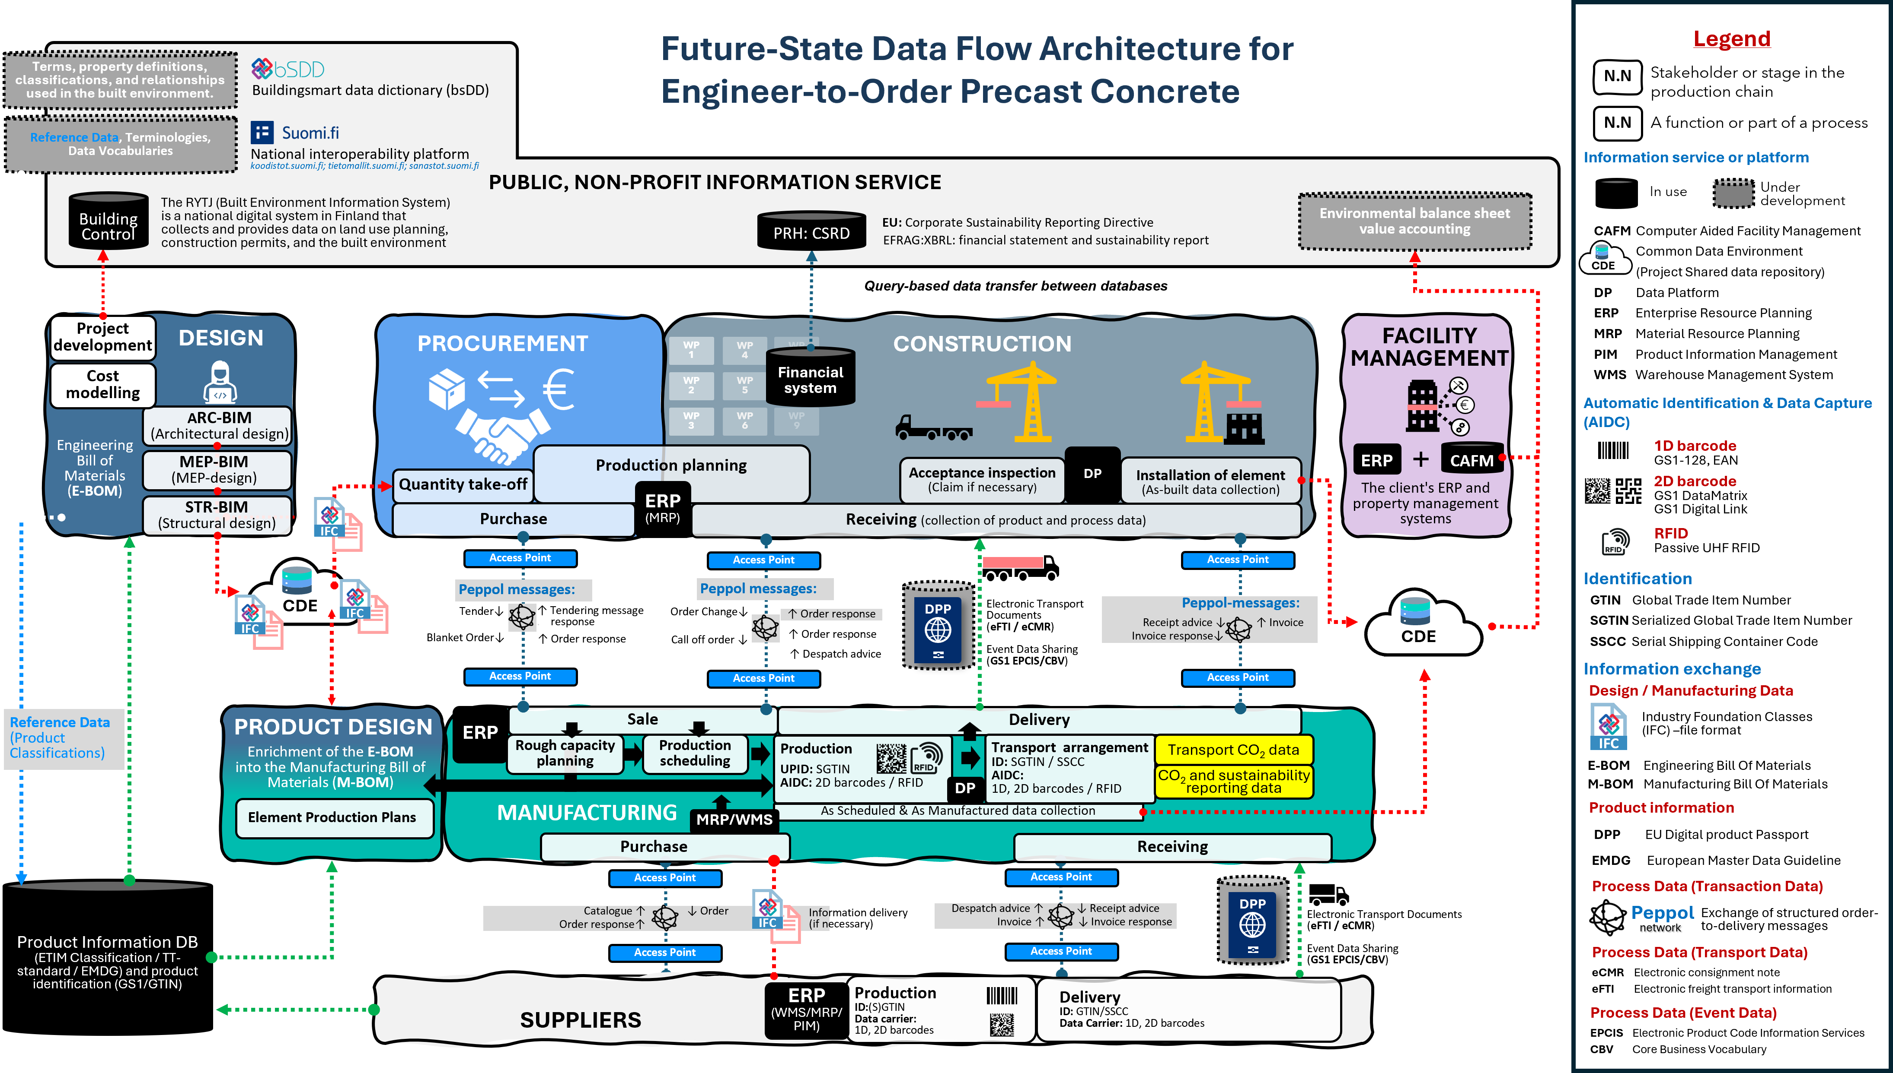
Future State Data Flow Architecture
for Engineer-to-Order Precast Concrete
Our development work follows the TOGAF framework and the national JHS-179 architecture principles to build an industry-level architecture for different production strategies.
The Future State Data Flow Architecture serves as a key representation combining process (action) and data architecture. It illustrates data repositories, interfaces, and core process functions of a digitized supply chain.
The data architecture diagram functions as an evolving artefact throughout the development project.
Current State
Development roadmap
Future State
Notes:
Our development work follows the TOGAF framework and the national JHS-179 architecture principles to build an industry-level architecture for different production strategies.
The Future State Data Flow Architecture representation brings together both process and data perspectives. It shows how information moves across the supply chain — the data repositories, interfaces, and core process functions that enable a digital way of working.
This data architecture diagram is not static — it serves as an evolving artefact that develops and matures throughout the project.

Slide 13






















Future-State Data Flow Architecture for Engineer-to-Order Precast Concrete
Legend
Terms, property definitions, classifications, and relationships
used in the built environment.
N.N
Stakeholder or stage in the production chain
Buildingsmart data dictionary (bsDD)
Reference Data, Terminologies,
Data Vocabularies
N.N
A function or part of a process
National interoperability platform
koodistot.suomi.fi; tietomallit.suomi.fi; sanastot.suomi.fi
Information service or platform
PUBLIC, NON-PROFIT INFORMATION SERVICE
In use
Under development
Building Control
The RYTJ (Built Environment Information System) is a national digital system in Finland that collects and provides data on land use planning, construction permits, and the built environment
EU: Corporate Sustainability Reporting Directive
Environmental balance sheet value accounting
PRH: CSRD
EFRAG:XBRL: financial statement and sustainability report
CAFM Computer Aided Facility Management
Common Data Environment
(Project Shared data repository)
DP Data Platform
ERP Enterprise Resource Planning
MRP Material Resource Planning
PIM Product Information Management
WMS Warehouse Management System
Query-based data transfer between databases
CDE
Project development
DESIGN
PROCUREMENT
WP
1
WP
4
WP
7
CONSTRUCTION
FACILITY MANAGEMENT
Cost modelling
Financial system
WP
2
WP
5
WP
8
Automatic Identification & Data Capture (AIDC)
ARC-BIM
(Architectural design)
WP
3
WP
6
WP
9
Engineering
Bill of Materials
(E-BOM)
MEP-BIM
(MEP-design)
Production planning
DP
ERP
+
CAFM
1D barcode
GS1-128, EAN
Quantity take-off
Acceptance inspection
(Claim if necessary)
Installation of element
(As-built data collection)
The client's ERP and property management systems
2D barcode
GS1 DataMatrix
GS1 Digital Link
STR-BIM
(Structural design)
Purchase
ERP
(MRP)
Receiving (collection of product and process data)
IFC
RFID
Passive UHF RFID
Access Point
Access Point
Access Point
Identification
Peppol messages:
Peppol messages:
DPP
Electronic Transport Documents
(eFTI / eCMR)
Event Data Sharing
(GS1 EPCIS/CBV)
Peppol-messages:
Receipt advice ↓ ↑ Invoice
Invoice response↓
GTIN Global Trade Item Number
SGTIN Serialized Global Trade Item Number
SSCC Serial Shipping Container Code
CDE
IFC
Tender↓
↑ Tendering message . response
Order Change↓
↑ Order response
IFC
Blanket Order↓
↑ Order response
Call off order ↓
↑ Order response
CDE
↑ Despatch advice
Information exchange
Access Point
Access Point
Access Point
Design / Manufacturing Data
Reference Data (Product Classifications)
PRODUCT DESIGN
ERP
Sale
Delivery
Industry Foundation Classes (IFC) –file format
Enrichment of the E-BOM into the Manufacturing Bill of Materials (M-BOM)
Rough capacity planning
Production scheduling
Production
UPID: SGTIN
AIDC: 2D barcodes / RFID
Transport arrangement
ID: SGTIN / SSCC
AIDC:
1D, 2D barcodes / RFID
Transport CO₂ data
IFC
DP
CO₂ and sustainability reporting data
E-BOM Engineering Bill Of Materials
M-BOM Manufacturing Bill Of Materials
Element Production Plans
MANUFACTURING
MRP/WMS
As Scheduled & As Manufactured data collection
Product information
Purchase
Receiving
DPP EU Digital product Passport
EMDG European Master Data Guideline
Product Information DB
(ETIM Classification / TT-standard / EMDG) and product identification (GS1/GTIN)
Access Point
Access Point
DPP
Process Data (Transaction Data)
Catalogue ↑ ↓ Order
Order response↑
Information delivery
(if necessary)
Despatch advice ↑ ↓ Receipt advice
Invoice ↑ ↓ Invoice response
Electronic Transport Documents
(eFTI / eCMR)
Event Data Sharing
(GS1 EPCIS/CBV)
Peppol
Exchange of structured order-to-delivery messages
IFC
network
Access Point
Access Point
Process Data (Transport Data)
Sale
ERP
(WMS/MRP/
PIM)
Production
ID:(S)GTIN
Data carrier:
1D, 2D barcodes
Delivery
ID: GTIN/SSCC
Data Carrier: 1D, 2D barcodes
eCMR Electronic consignment note
eFTI Electronic freight transport information
SUPPLIERS
Process Data (Event Data)
EPCIS Electronic Product Code Information Services
CBV Core Business Vocabulary
Notes:
The Future State Data Flow Architecture shown here represents the stakeholders and stages of the production chain. It includes functions and process components, as well as the information services and platforms that enable data exchange.
The diagram illustrates information exchange interfaces, and core process functions of a digitized supply chain, highlighting product identification.
Also, the exchange of design data, product information, transactional data, transport data, and event data between stakeholders.
Thank you, that was my presentation.

